Slide 1

A Realistic Introduction to
Iva Čukić, PhD
University of Liverpool
Publich Health, Policy and Systems
14 May, 2021

Slide 2
Cou se outline
The R/R Studio environment
Basic operations and logic
11:15-11:30 Coffee Break
“Cleaning” the variables
Descriptive statistics
1-1:40pm Lunch
Testing group differences: t-test, anova
Predicting the outcome: linear and logistic regression
3:15-3.30 Coffee Break
Exercises

Slide 3
What is R anyway?
Software environment for statistical computing and data visualisation, free under the GNU General Public Licence
Extension of the S programming language, created in 1976 at Bell Labs
R was created by Ross Ihaka and Robert Gentleman in 1992, at the University of Aukland, NZ
It is currently developed and maintained by the R Development Core Team at https://www.r-project.org/

Slide 4
Installing R and R Studio
R version 4.0.2 ("Taking Off Again”)
Windows: https://cran.r-project.org/bin/windows/base/
Mac: https://cran.r-project.org/bin/macosx/
R Studio Desktop version 1.1463 https://www.rstudio.com/products/rstudio/download/#download

Slide 5
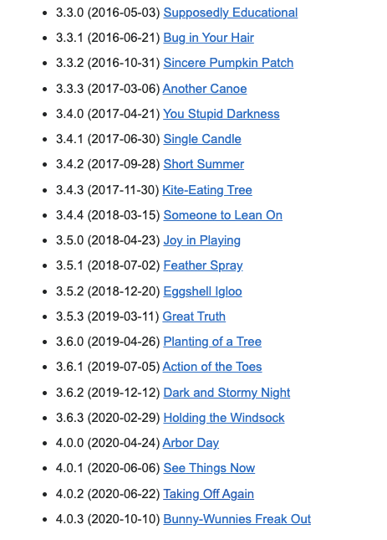


Slide 6
What does R look like?
>

Slide 7
R Studio to the rescue! (Somewhat)

Slide 8
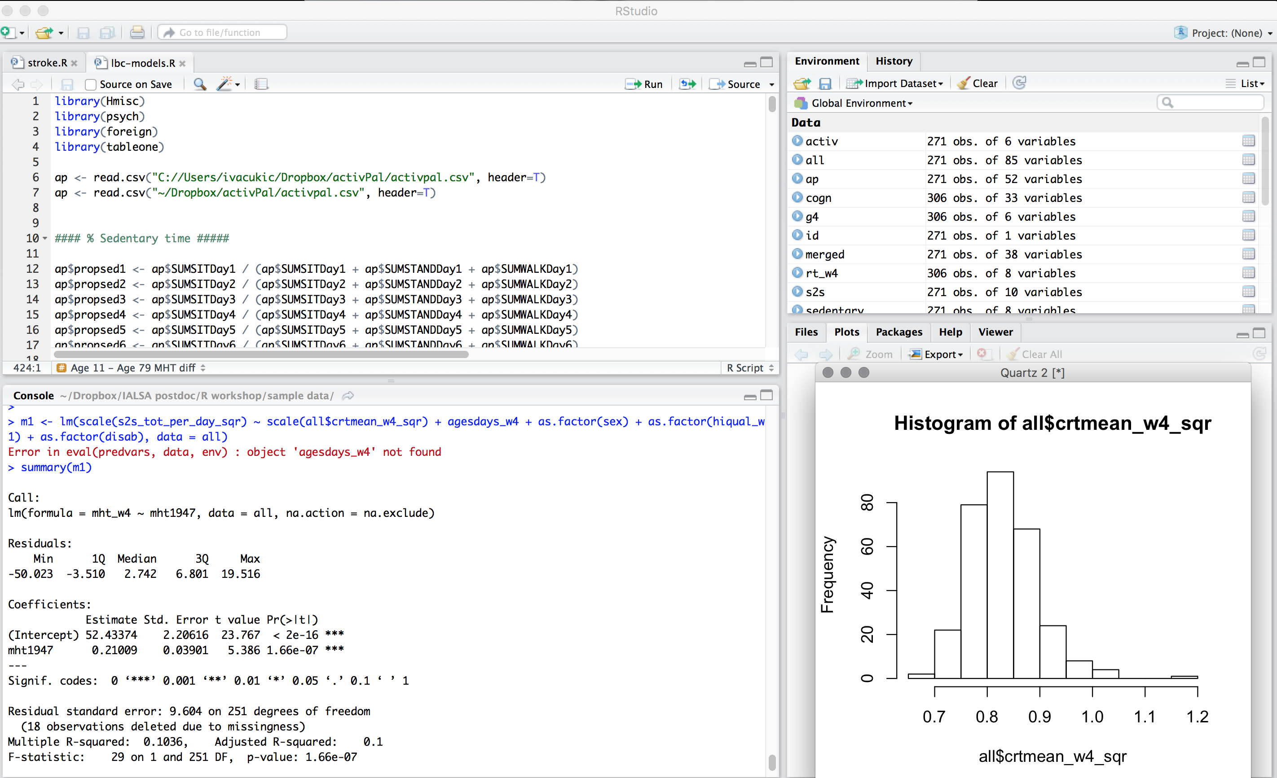

Slide 9
Structure
Scripts
text file where all your code is written
Data
spreadsheet like matrix with variables and participants
Console
where we execute our commands and see outputs
Tons more

Slide 10
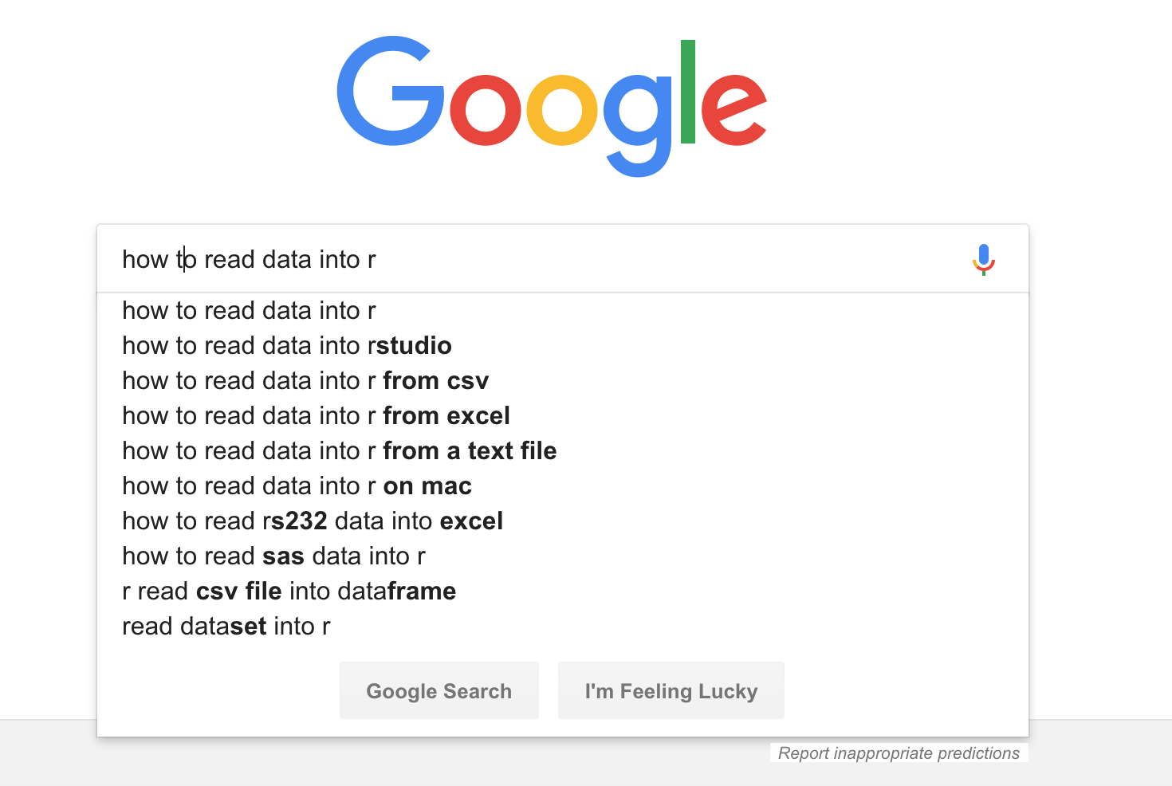
Your best friend

Slide 11
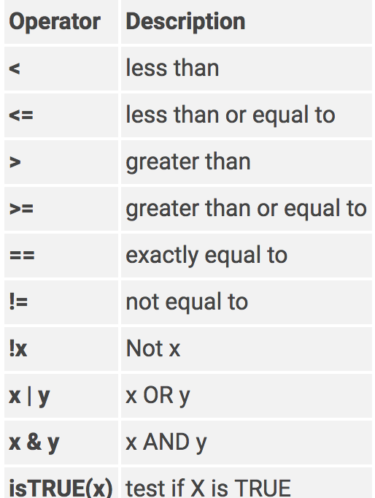
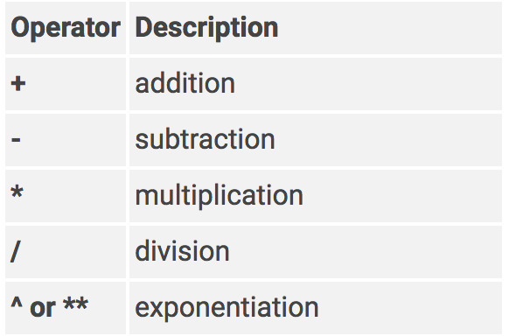
Operators
Logical
Arithmetic

Slide 12
Download practice data sets
Create working directory on your computers (with known path!)
Download datasets:
https://github.com/ivacukic/Realistic-Introduction-to-R

Slide 13
Resources
Edinburgh R Meetup
http://edinbr.org/
R Bloggers
https://www.r-bloggers.com/
Stack Overflow
https://stackoverflow.com/
John Hopkins University Coursera Course
https://www.coursera.org/learn/r-programming
Data Camp Course
https://www.datacamp.com/courses/free-introduction-to-r

